Slide 1

Check list

Slide 2
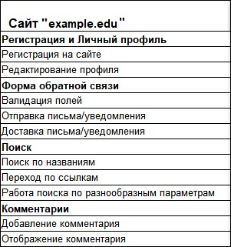
Check list
A check list is a list containing a number of necessary checks during testing of a software product. By marking the items on the list, a team or one tester can find out about the current status of the work done and about the quality of the product.
Checklists are arranged very simply. Any of them contains a list of blocks, sections, pages, other elements that should be tested.

Slide 3

Each checklist has multiple columns. Each column is designed to be tested on a separate platform. The name of the device, browser and its version should always be indicated.
Several people can test the application at the same time. In this case, each tester takes one or two platforms and tests only on them. In this case, you should indicate a tester opposite each platform

Slide 4
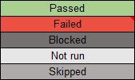
Status
When passing the checklists, the tester notes the status in front of each item being tested. The following status options are possible:
“Passed” - the verification was successful, no bugs were found;
“Failed” - one or more bugs were found;
"Blocked" - it is impossible to verify, because one of the bugs blocks the current scan;
“In Progress” - the current item the tester is working on;
“Not run” - not yet verified;
“Skipped” - will not be checked for any reason. For example, the current functionality has not yet been implemented.

Slide 5
Focal points
Upon completion of the checklist, there should be no cells with the status “Not run”.
All cells with the status of “Failed” and “Blocked” must have notes with links to bug reports.
The status "Passed" is set only for items that are checked and do not contain errors.

Slide 6
Conclusions
A checklist is needed to:
Do not forget the required tests.
Share tasks by skill level.
Save reporting and test results.
The checklist contains:
List of checks (with the required level of detail).
Verification Environment: assembly on which testing was carried out; test environment (if applicable); information about the tester.
Result of checking.

